Slide 1
CORRELATION BETWEEN NEIGHBORHOOD REAL ESTATE PRICE AND ITS SURROUNDING VENUES
Ravi Kiran Badathala

Slide 2
PROJECT INTRODUCTION:
This project is the capstone for the 9-courses IBM Data Science professional certificate on Coursera.
The requirement is leveraging the Foursquare location data to explore or compare neighborhoods or cities of your choice or to produce a problem that you can use the Foursquare location data to solve.
The chosen topic is the correlation between the real estate value and its surrounding venues.
The idea comes from the process of, any family searching a home to stay after moving to another city. It is common that the owners or agents advertise their properties are closed to some kinds of venues like
supermarkets, restaurants, public transport, hospital, school or coffee shops, etc.; showing the “convenience” of the location in order to raise their house’s value to sale or rent.

Slide 3
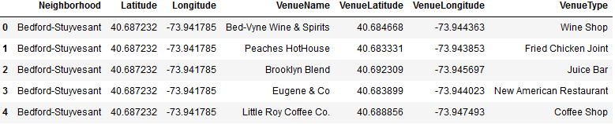
DATA ACQUISITION AND CLEANING:
Scrap CityRealty website for neighborhoods average prices:
URL: https://www.cityrealty.com/nyc/marketinsight/
features/get-to-know/average-nyc-condoprices-neighborhood-june-2018/18804
Get the neighborhoods coordinate:
Free geodata is available free at: https://geo.nyu.edu/catalog/nyu_2451_34572

Slide 4
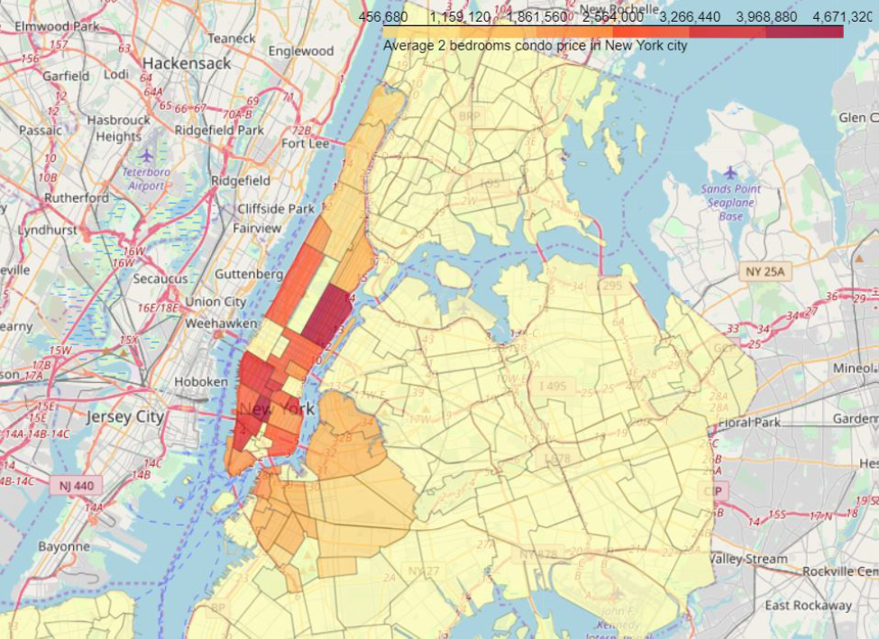
NEW YORK CITY NEIGHBOURHOODS IN
MANHATTAN AND BROOKLYN
WERE CHOSEN AS THE OBSERVING TARGET.

Slide 5
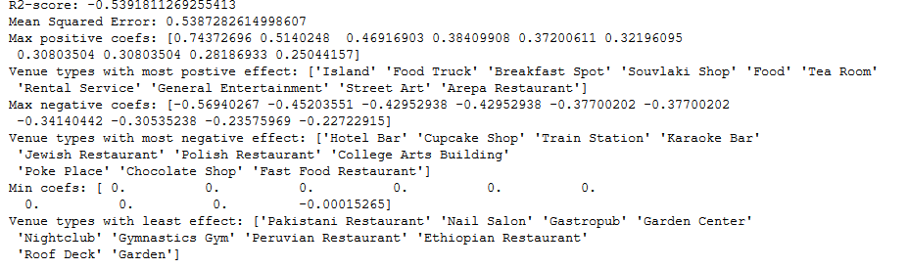
ANALYSIS:
CHECK FOR CORRELATION BETWEEN OCCURRENCE OF SURROUNDING
VENUES WITH REAL ESTATE AVERAGE PRICE:
THE RESULT DOESN'T LOOK
PROMISING:
• THE R2 SCORE IS negetive.
• THERE ARE NO REALLY STRONG
COEFFICIENT CORRELATIONS.

Slide 6
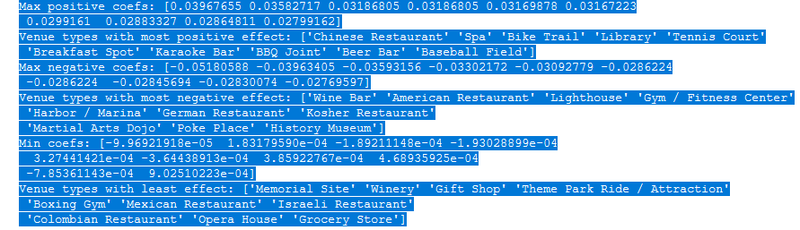

Trying for better result with PCR analysis
The results are still in the negative zone.
The ambiguity in result is due to lack of adequate data

Slide 7
Results
Based on the assumption that the price of a real estate is dependent on its surrounding venues.
Regression techniques were used to get the coefficient correlation between each venue type and the price. And at the end, producing a model to predict how higher or lower a neighbourhoods price
compared to the mean, based on the occurrence of its surrounding venue types.
First, Simple Linear Regression was used to see how the approach would perform. Then a more sophisticated method, Principal Component Regression (PCR), was applied to improve the result.
Unfortunately, the end result isn't very promising. With the R2 score (or Coefficient of determination) with negative of -0.18,
the model isn't really fit to the data set; and thus, can't be used for further predicting the real estate price.

Slide 8
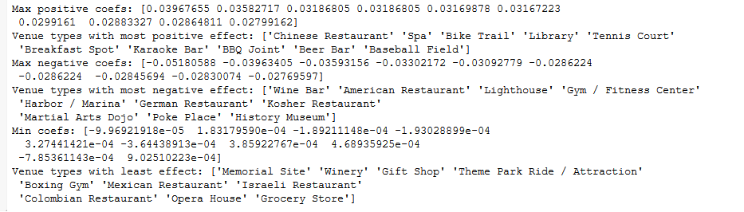
BUT ON THE BRIGHT SIDE, INTERPRETING THE COEFFICIENT LIST GAVE AN INSIGHT THAT SEEMS TO BE LOGICAL:

Slide 9
Obserations
Venue types like "Studios" or fancy "Eateries" usually located in busy areas, where there are lots and lots of people seeking their services. And that's usually where people, who love the bustling atmosphere of New York city, would love to live nearby. High demand equals high price.
On the other hand, venue types like "TV station", "Cemetery", "Mini Golf", etc. usually are not important factors to most people when looking into a neighborhood. So, they don't have much effect to the price.

Slide 10
Conclusion and Observation
First, about the data. Real estate prices are not usually available to the public. So, collecting a large set is impossible without connections with some real estate agencies. In this project, there are only 50 samples, but with more than 300 features. Since collecting more samples is not possible now, PCR was chosen to solve the problem by reducing the features size before applying regression.
Second, about the analysis process and conclusion. With no formal academic background in statistics and mathematics, the tools and methods might not be used with their optimal configuration. And the insight might not be drawn out fully, or even worse not correct at all. Further study in statistical inference and multivariate statistical analysis after this program is a must.

